Slide 1

University Shuttle Routing and Tracking Service
Final Year Project
1st April, 2019

Slide 2
Introduction
1/2 Minute

Slide 3



Our Group Members
Final Year Project
CS
CS
CS
Azel Daniel
816002285
Michael Bristol
816003612
Amanda Seenath
816002935

Slide 4
The Problem
1 Minute

Slide 5
The Problem
The problem that our project addresses
UWI Shuttle Service
Does not strictly follow scheduled interval
May not arrive to destination on time
Students
Left stranded without transportation
Inconvenienced
Not offered the security benefits

Slide 6
The Solution
The basic solution that our project offers
How do we solve this problem?
List shuttles and their real-time location
Estimated time of arrival
Reinforces the purpose of using the shuttles
As a result offers a secure and reliable transportation

Slide 7
The Main Beneficiaries
1/2 Minute

Slide 8
Main Beneficiaries
Who are the main beneficiaries of the project?
1
2
3
UWI Students
Shuttle Drivers
Campus Security
4
5
6
Group Members
Course Lecturers
Administrative Staff at UWI

Slide 9
Project Significance
1/2 Minute

Slide 10
Project Significance One Column
How significant is the software solution?
There are currently no services in place which provides a solution to the problem.
Its very useful as many students complained about the inefficiency of the service being a major deterrent in using it.

Slide 11
Goals and Objectives
1 Minute

Slide 12
Goals and Objectives
What are the goals and objective s of the project?
Specify user requirements
Specify design for product
Understanding the existing system
Develop the application
Application Testing

Slide 13
System Prototype
1/2 Minute

Slide 14
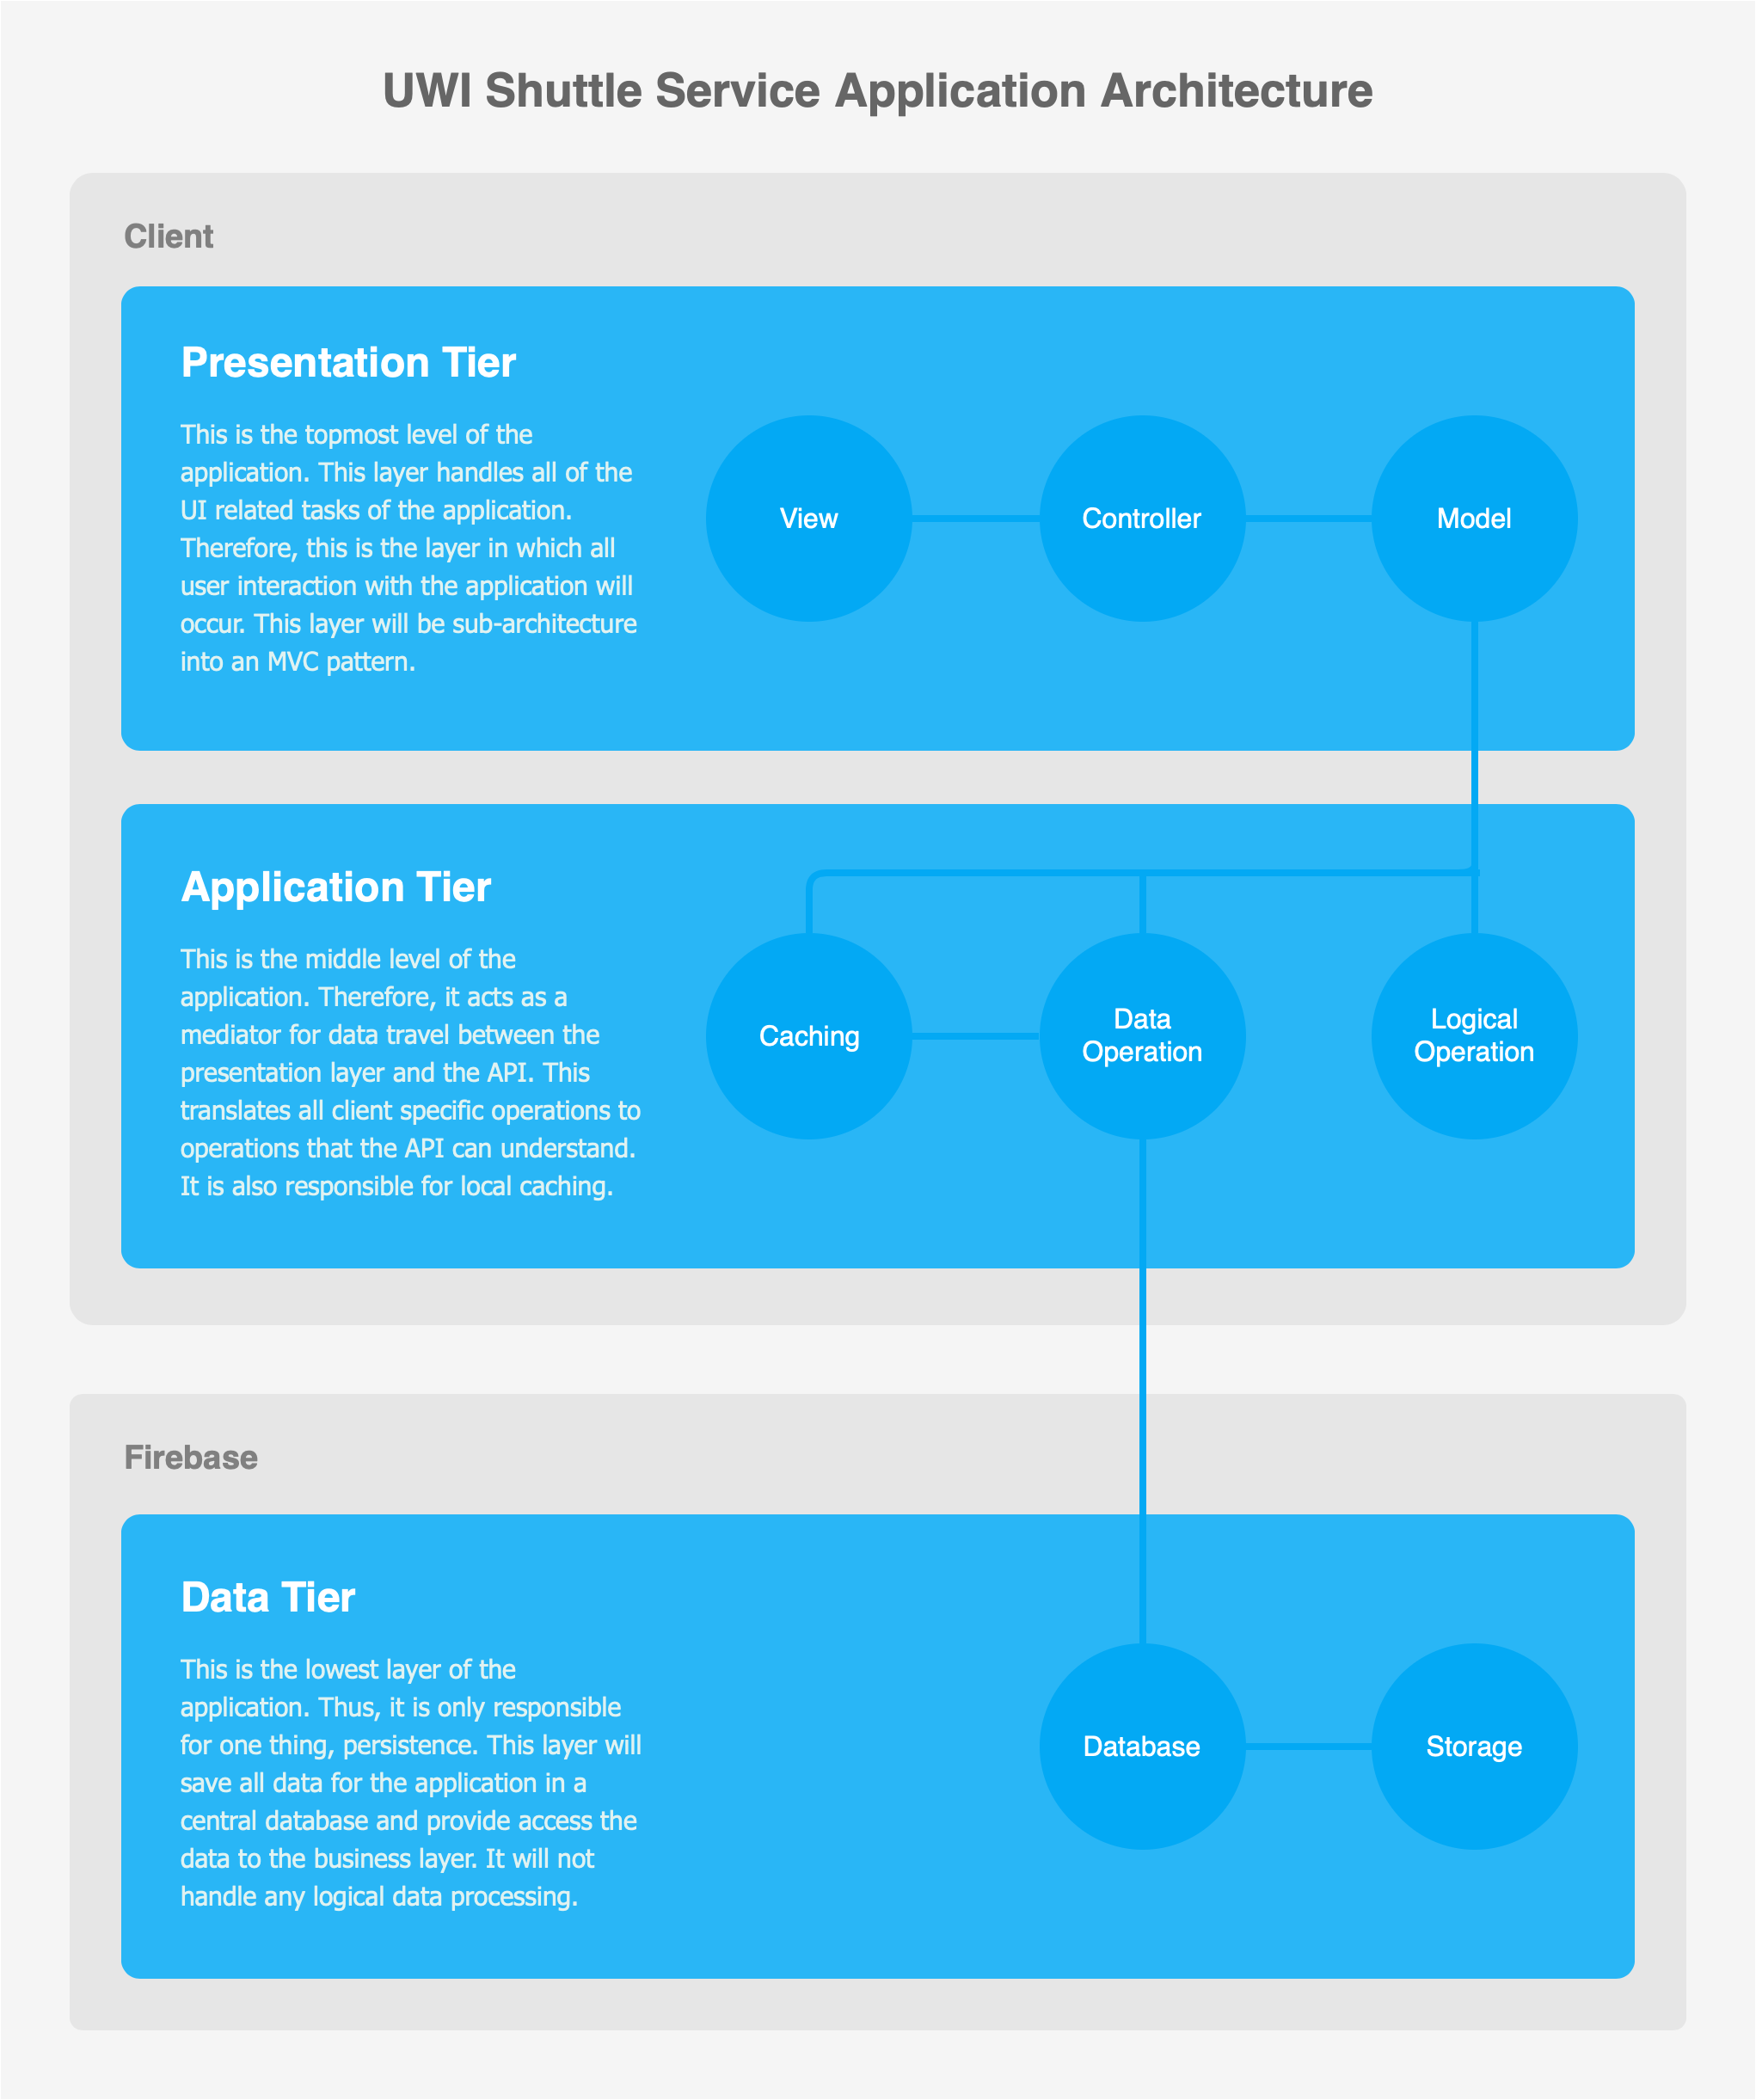
System Prototype
Overal Architecture

Slide 15
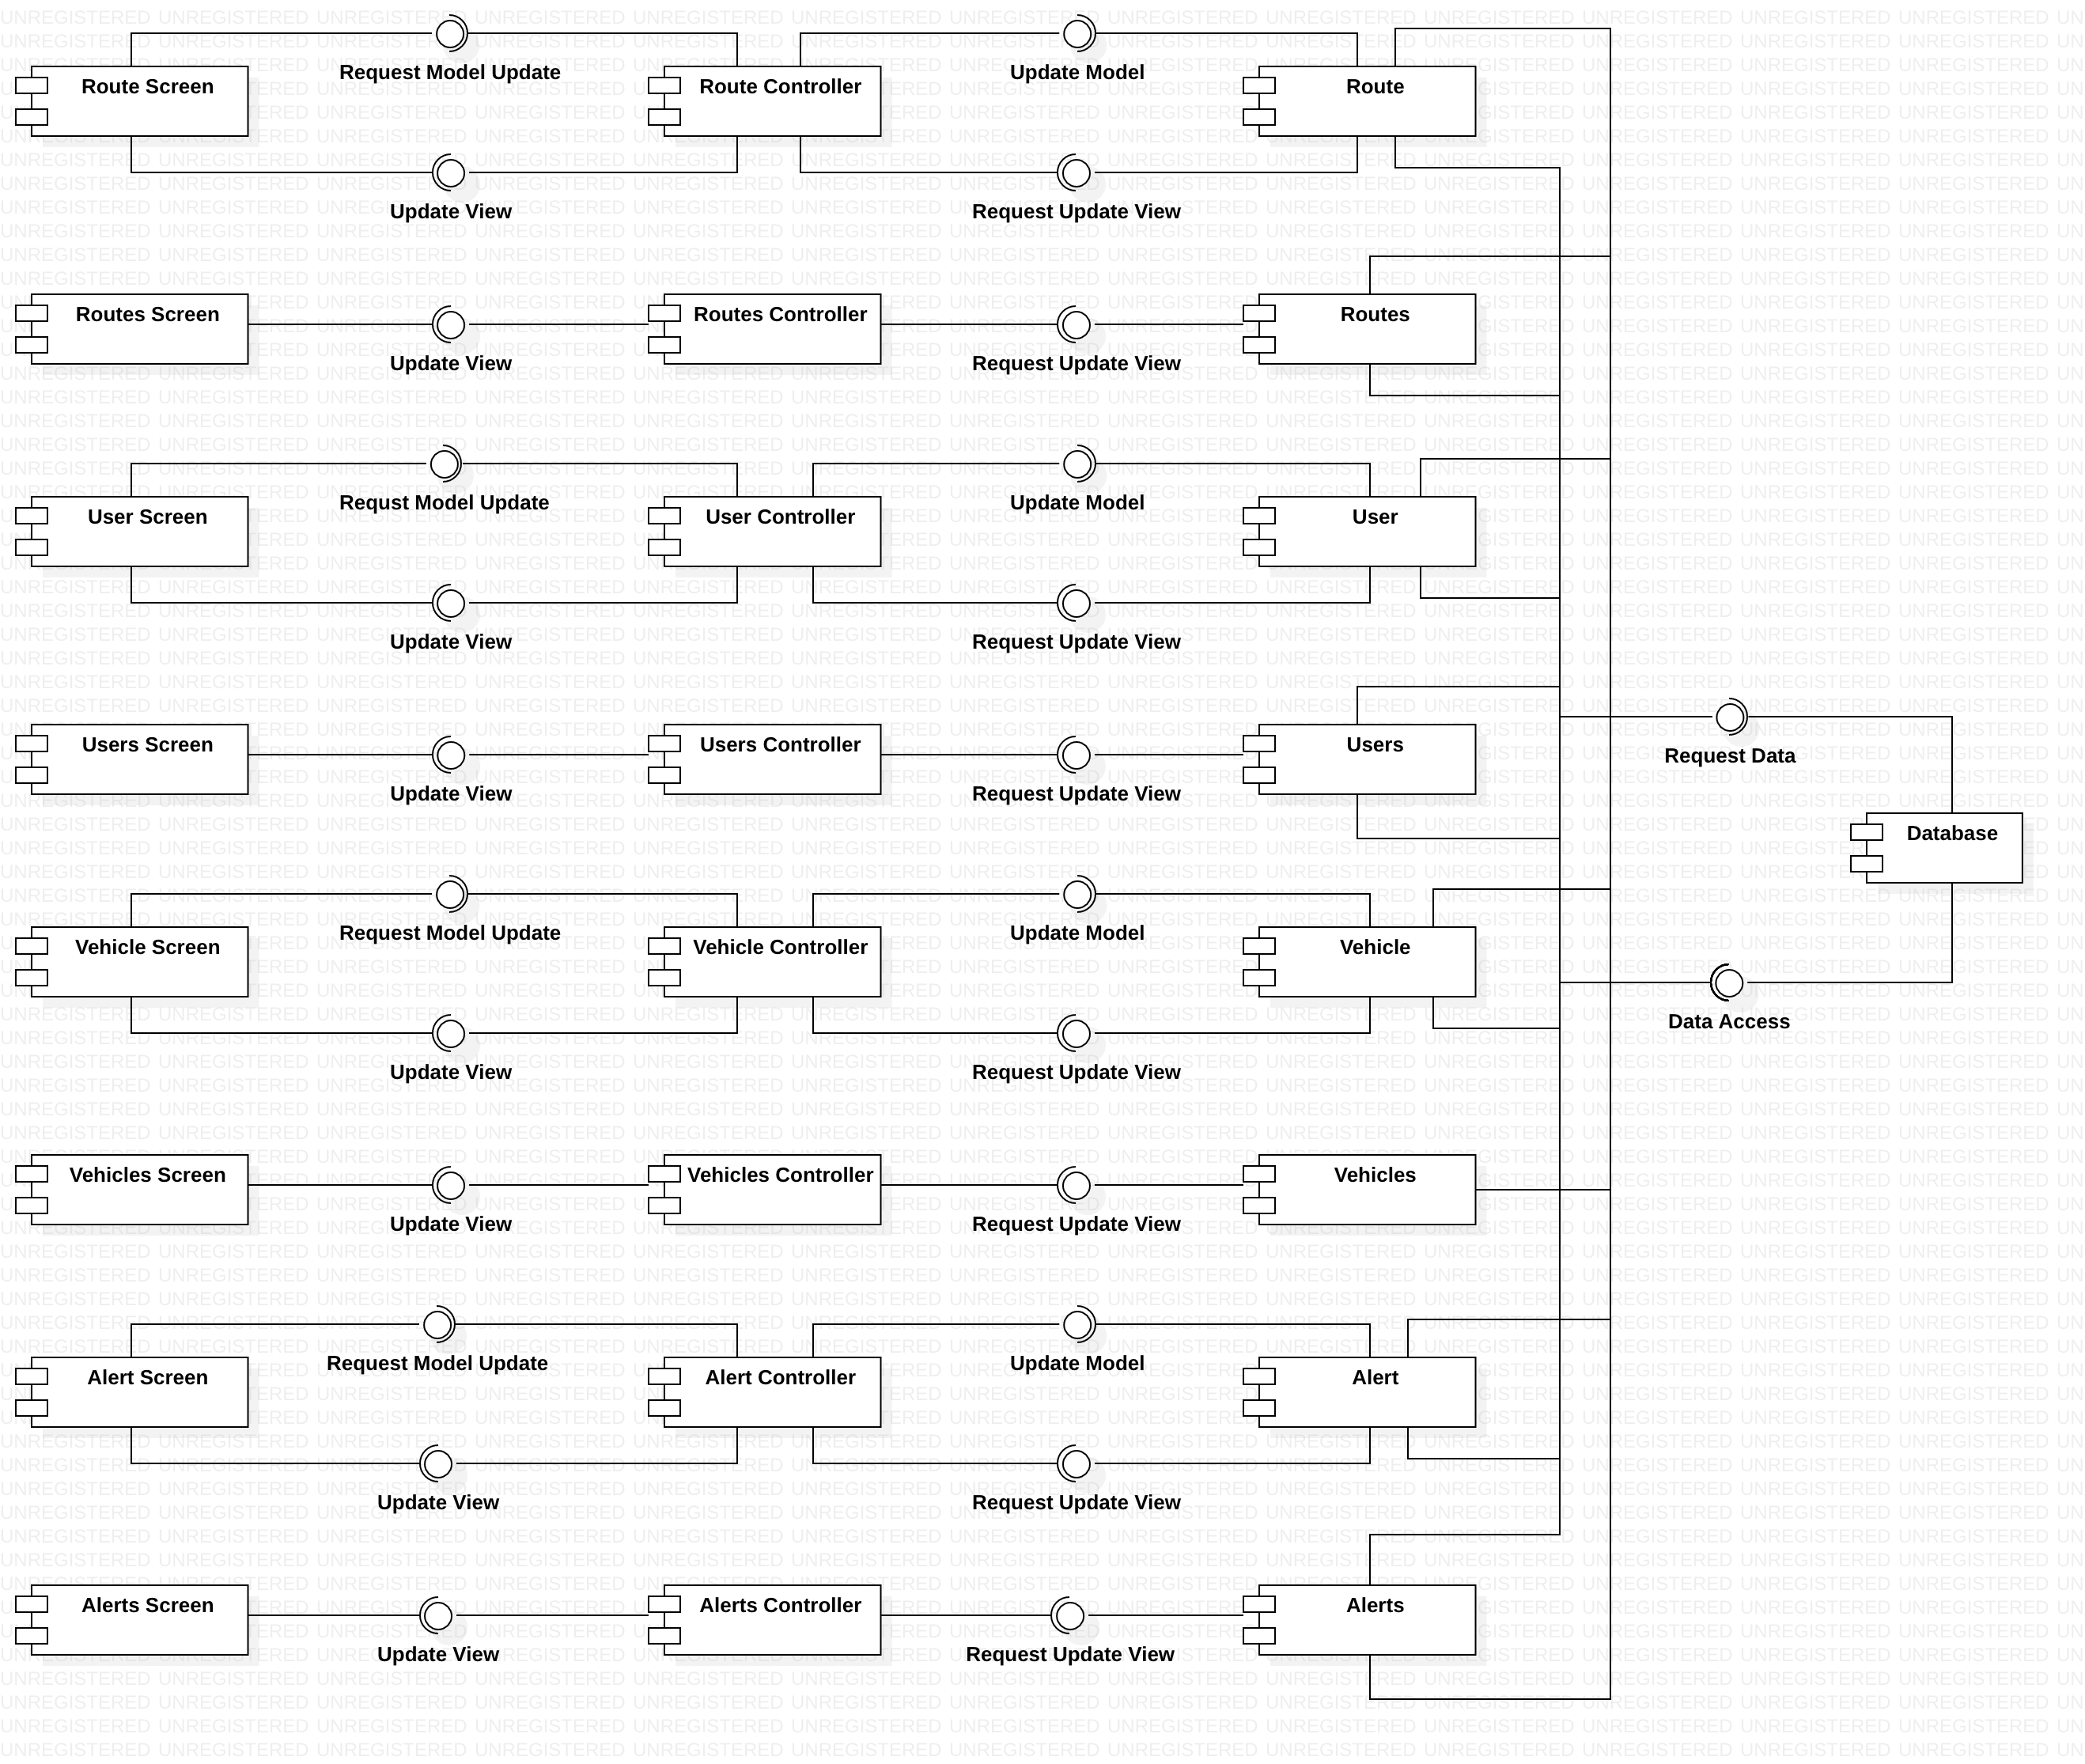
System Prototype
Component diagram

Slide 16

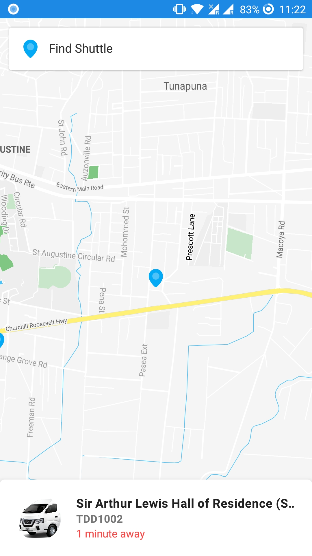
UWI SRTS Project
View Shuttles Screen
To be used by students
Track all on duty UWI shuttles in real time
Track a specific UWI shuttle in real time
Get estimated times of arrival of the shuttle to your location (in progress)

Slide 17
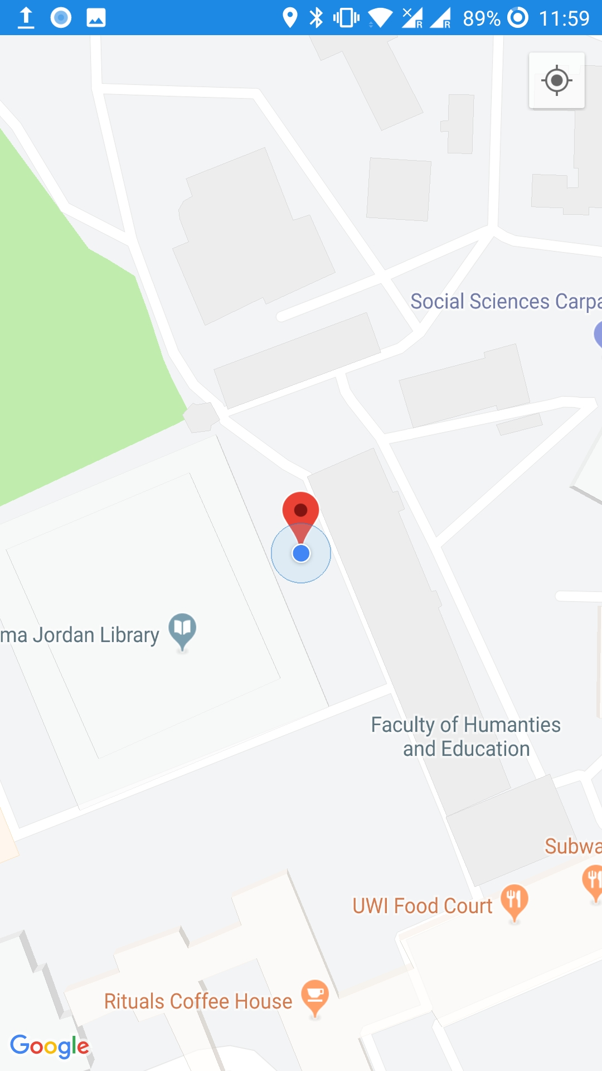
UWI SRTS Project
Track Shuttle Screen
To be used by drivers
Tracks the movement of a single shuttle and sends the location information to the database
Show traffic information (in progress)
Allow drivers to go to other screen to issue informational alerts

Slide 18
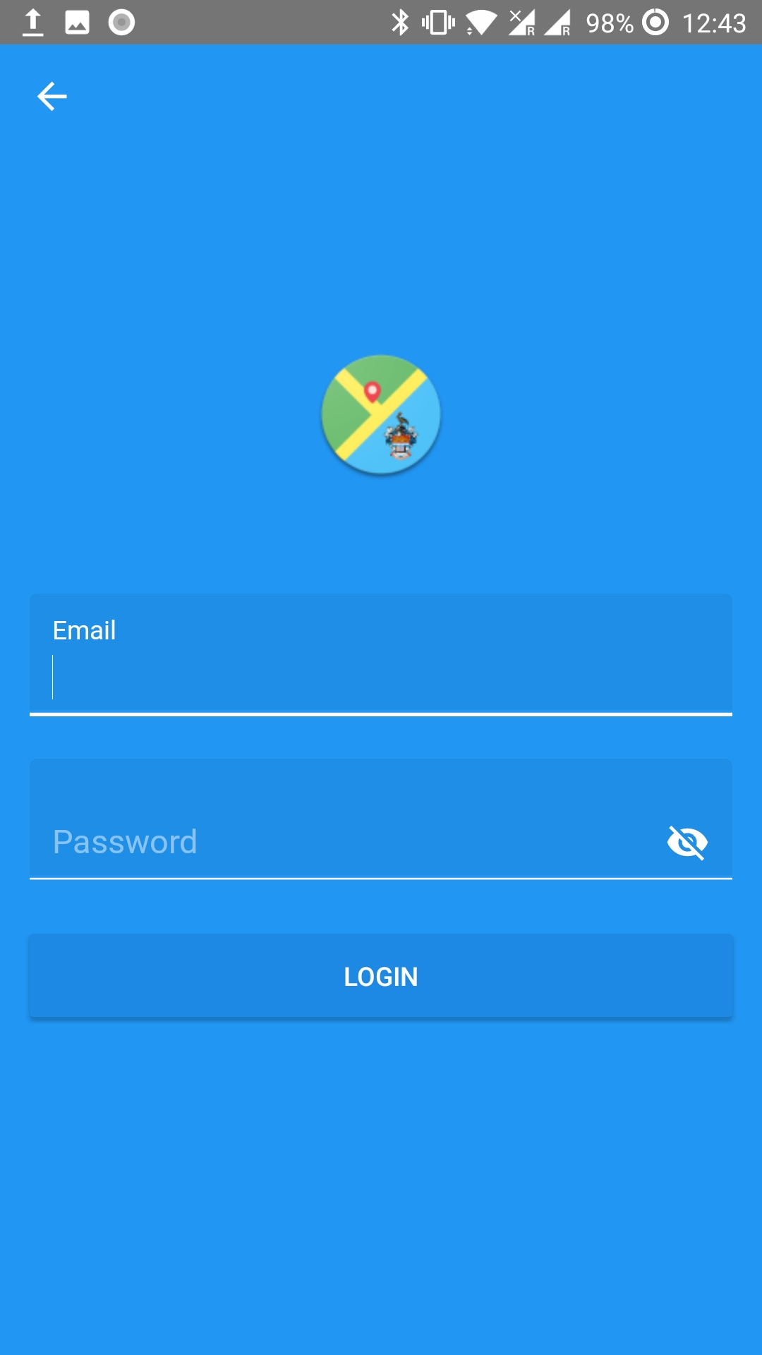
UWI SRTS Project
Login Screen
To be used by all users
Drivers have to enter email (or staff id) and password
Students only have to enter their UWI email (optional)
Entering the UWI email is optional for students; however, it allows them to get more details on the shuttles if their email are verified.

Slide 19
Technologies Used
The main technologies used in the project
1
2
3
Mobile Phones
Java
Android Studio
4
5
6
UWI SRTS
Firebase Realtime Database
Google Maps API

Slide 20
Project Progress
1/2 Minute

Slide 21
Project Progress
The basic solution that our project offers
Design in complete
Iteration 1 is almost complete
System testing is ongoing

Slide 22
Thank You!

